Slide 1
Implementation of Optical Flow
Group 3
S/18/427 - Janith Kulatunga
S/18/030 - Supul Edirisinghe
S/18/562 - Sanjana Wijenayaka
S/18/335 - Sachini Dasa
S/18/557 - Nilmi Wickramasinghe

Slide 2
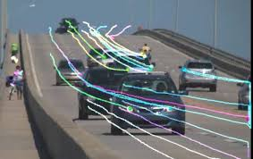
What is optical flow
Pattern of apparent motion of objects, surfaces, and edges in a visual scene caused by the relative motion between the observer (camera) and the scene
It calculates the motion between two consecutive frames in a sequence, assuming that intensity of pixels remains constant.
Notes:
Motion Detection and Tracking:
Action Recognition:
Video Stabilization:.

Slide 3
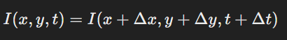
Mathematical formalization for optical flow
Brightness constancy assumption
Figure 2: Brightness constancy assumption equation
I(x,y,t) is the intensity of the pixel at position (x,y) at time t.
Δx and Δy are small displacements in the horizontal and vertical directions, respectively,
Δt is the small time step between consecutive frames.

Slide 4
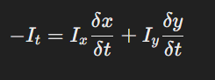
Mathematical formalization for optical flow
Optical flow constraint equation
Optical flow constraint equation
After taylor series expansion
expresses the fact that the change in intensity over time (It) can be related to the motion in the x and y directions, weighted by their respective intensity gradients.

Slide 5
Types of optical flow Algorithms
Block based methods - Based on partial spatial and temporal derivatives of the image signal.
Differential Methods - Assume that motion between two frames is small, and they compute the flow by estimating the spatial and temporal image intensity gradients.
Lucas-Kanade Method
Horn-Schunck Method
Farnebäck Method

Slide 6
Lucas-Kanade Method
Divide image into patches and computing a single optical flow on each of them.
Key Characteristics:
Suitable for small motions and can handle noise well.
Often used for sparse optical flow, i.e., calculating motion for only a subset of points.
Advantages: Computationally efficient and robust to noise in small regions.
Limitation: Assumes a locally constant flow, which might not work well for larger displacements or non-uniform motion.

Slide 7
Fast computation of optical flow Implementation
Steps-
1.Video Capture Initialization
2.Convert First Frame to Grayscale
3.Mask Initialization
4.Looping Through Video Frames
5.Optical Flow Calculation
6. Magnitude and Angle of Flow
7.Visualizing the Optical Flow

Slide 8
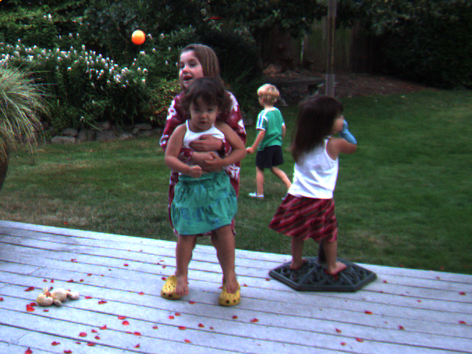
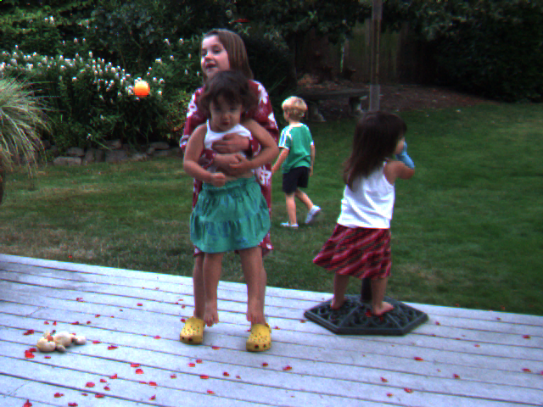
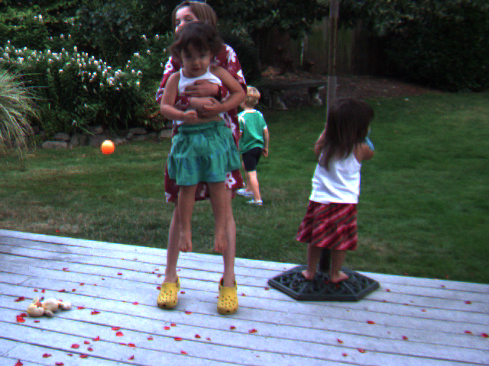
Data set
Dataset Link - https://vision.middlebury.edu/flow/data/

Slide 9
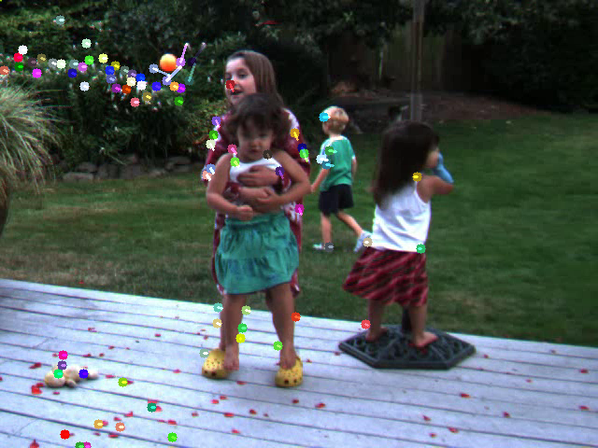
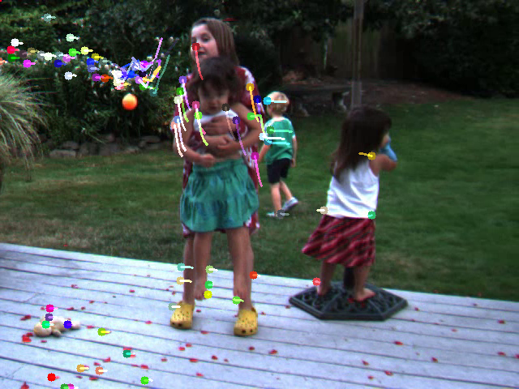
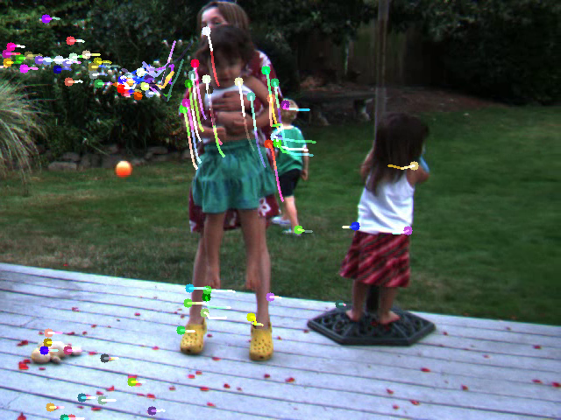
Results from Lucas - Kanade

Slide 10
Results from Lucas - Kanade

Slide 11
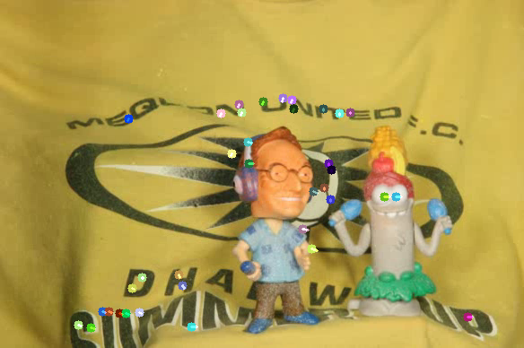
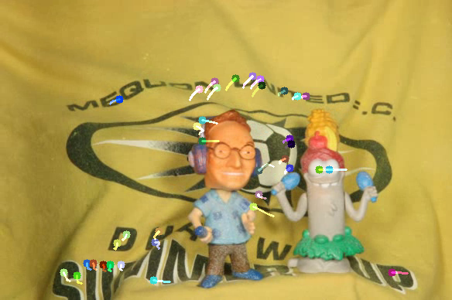
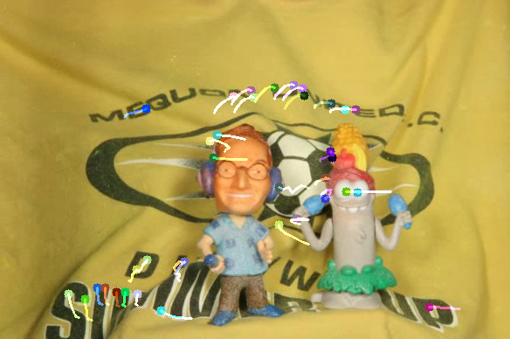
Results from Lucas - Kanade

Slide 12
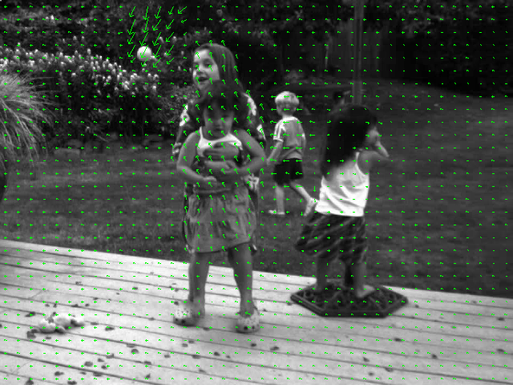
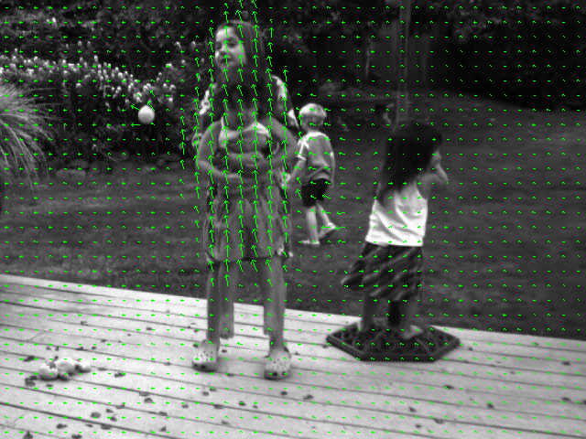
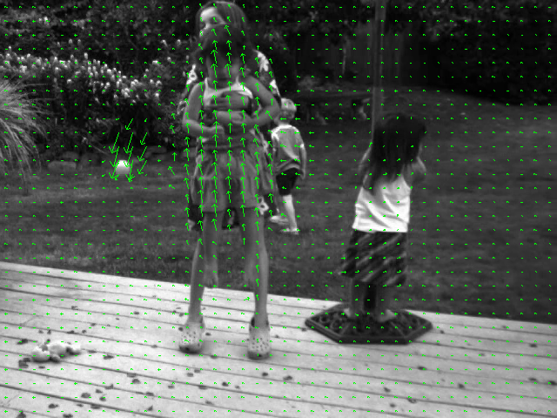
Results from Farneback method

Slide 13
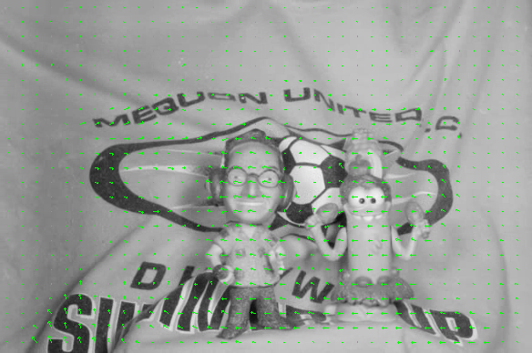
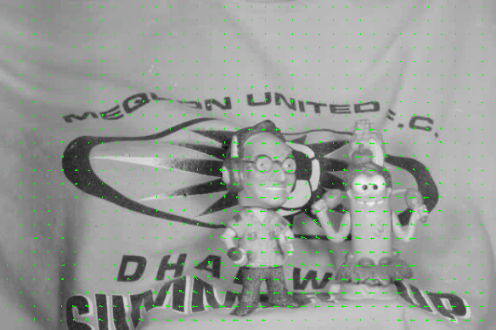
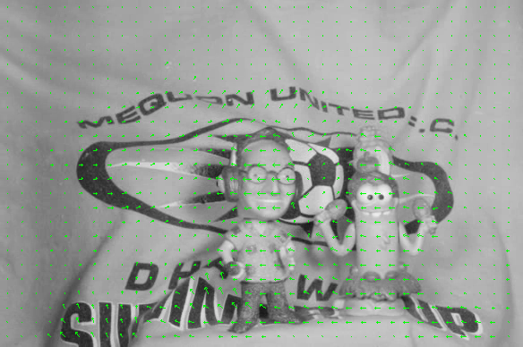
Results from Farneback method

Slide 14
Comparison of LK - Farneback (Dense) Optical Flow Methods
Dense method
LK method

Slide 15
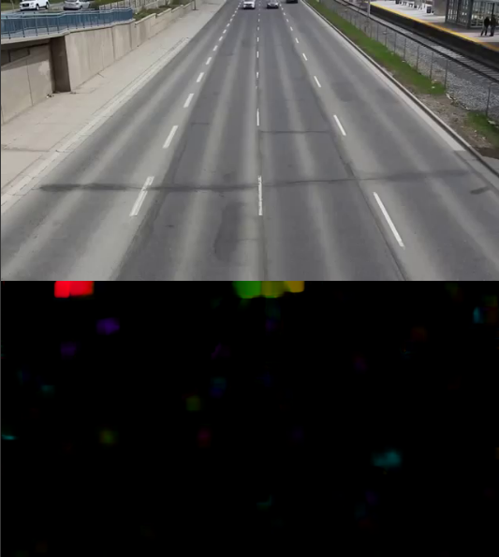
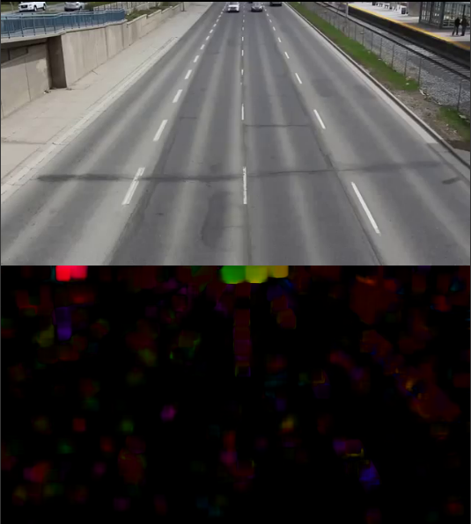
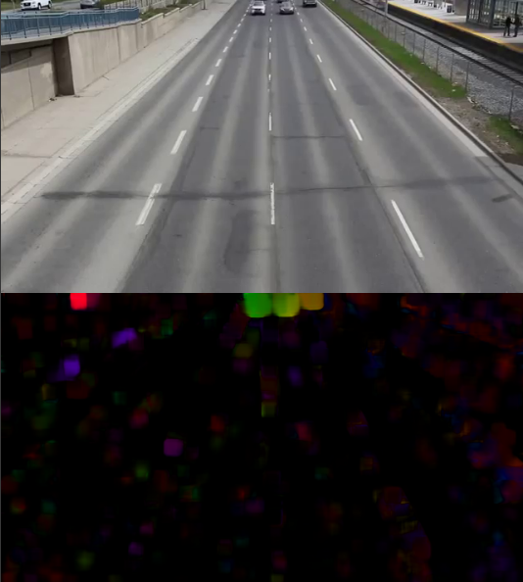
Results from Farneback dense flow

Slide 16
Applications of Lucas-Kanade
1.Real time object tracking - LK's efficiency makes it suitable for tracking objects in real-time applications like surveillance systems, autonomous vehicles, and human-computer interaction.
2.Motion estimation - LK is used to estimate the motion of objects in videos for tasks such as motion compensation, video stabilization, and video synthesis.
3.Image Registration - LK is employed to align medical images from different modalities or time points, facilitating accurate diagnosis and treatment planning.
4.Object Tracking - LK can be used to track real-world objects, allowing virtual objects to be seamlessly integrated into the scene.

Slide 17
Applications of Farneback
Video Compression - Farneback’s ability to estimate dense optical flow can be used to predict motion between frames, reducing redundant information and improving video compression efficiency.
Motion-based Segmentation - Farneback optical flow helps in segmenting moving objects from the background, useful in tasks like autonomous driving, video surveillance, and sports analytics.
Action Recognition - Farneback is used in human activity recognition to capture the motion of body parts, aiding in understanding and classifying actions in videos for sports, healthcare, or security purposes.
Slow-motion Video Generation - Farneback dense flow can estimate intermediate frames by predicting the motion between consecutive frames, allowing the creation of smooth slow-motion videos from regular footage.

Slide 18
Modern Trends in Optical Flow
Deep Learning-Based Approaches
Convolutional Neural Networks (CNNs)
Transformer Networks
FlowNet: A pioneering CNN architecture that directly estimates optical flow from image pairs.
Hybrid Approaches
PWC-Net: Combines traditional optical flow algorithms (like Pyramid Lucas-Kanade) with CNNs for improved accuracy.
FlowNet2.0: Incorporates a multi-task learning framework that jointly estimates optical flow, depth, and scene flow

Slide 19
Thank You!

